Slide 1
Current Concepts in Hemorrhagic Shock/Damage Control
Gregory Risk, MD, MPH, FACEP
Assistant Clinical Professor
OU School of Medicine

Slide 2
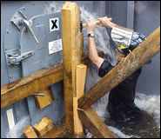
Damage Control
Stop Bleeding
Augment Clotting Factors
Redirect volume
Transfuse FWB

Slide 3
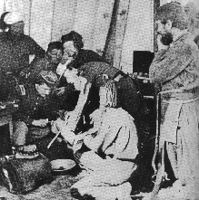
Civil War
Tourniquets
Chloroform anesthesia
Amputations
Survival =75%

Slide 4
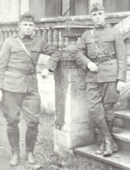
WWI Surgery
1908- Pringle: compression/perihepatic packing
1913-Halstad: rubber sheets between liver and packing to protect hepatic parenchyma
Evacuation times- hours/days

Slide 5
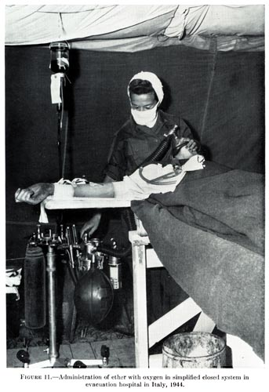
WW II
Development of gas anesthesia
Plasma available
Whole Blood transfusions
Antibiotics
Definitive repair norm

Slide 6
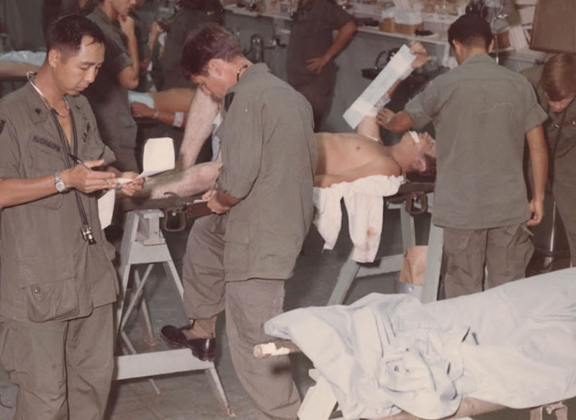
Vietnam
Rapid evacuation
Widespread use of ventilators
Crystalloid IV fluids and blood components
Definitive repair

Slide 7
……….the old becomes new….again
Stone, H, et al “Management of major coagulopathy with onset during laparotomy” Ann Surgery 1983
Carmona R, et al “The role of packing and planned reopening in severe hepatic trauma” J Trauma 1984
Rotondo, MF “ ‘Damage Control: An approach for improved survival in exsanguinating penetrating abdominal injury.” J Trauma 1993

Slide 8
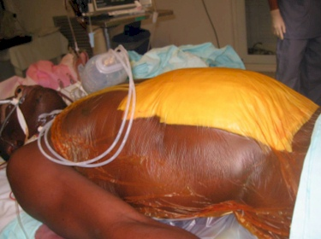
Damage Control Surgery
Control hemorrhage
Stop further contamination
Rapid towel clamp closure or open packing
Resuscitation in SICU
Return to OR in 24-48 hours for definitive repair.
Early identification of these patients leads us to……..
Notes:
Increase in survival by 20-60%

Slide 9
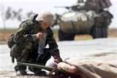
…….Damage Control Resuscitation
Hemorrhage control
Prevent hypothermia
Correct coagulopathy
Treat acidosis
Resuscitation
Extend Golden Hour ??

Slide 10
Hemorrhage control
Extremities-
Tourniquets
Groin/Axilla/Others
Hemostatic agents
Deeper sites

Slide 11
Hypothermia Effects
Delays ONSET thrombin generation
Slows platelet aggregation
Inhibits all enzymes (esterases) in coagulation cascade
Effects underappreciated with usual measures (PT/PTT)

Slide 12
Hypothermia
Hemorrhage→
Hypotension→
Reduced perfusion→
Decreased oxygen delivery→
Conversion from aerobic to anaerobic metabolism→
Decreased energy production→
Reduced heat production
Notes:
Krebs Cycles

Slide 13
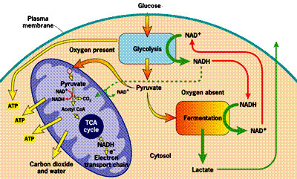
Cellular metabolism

Slide 14
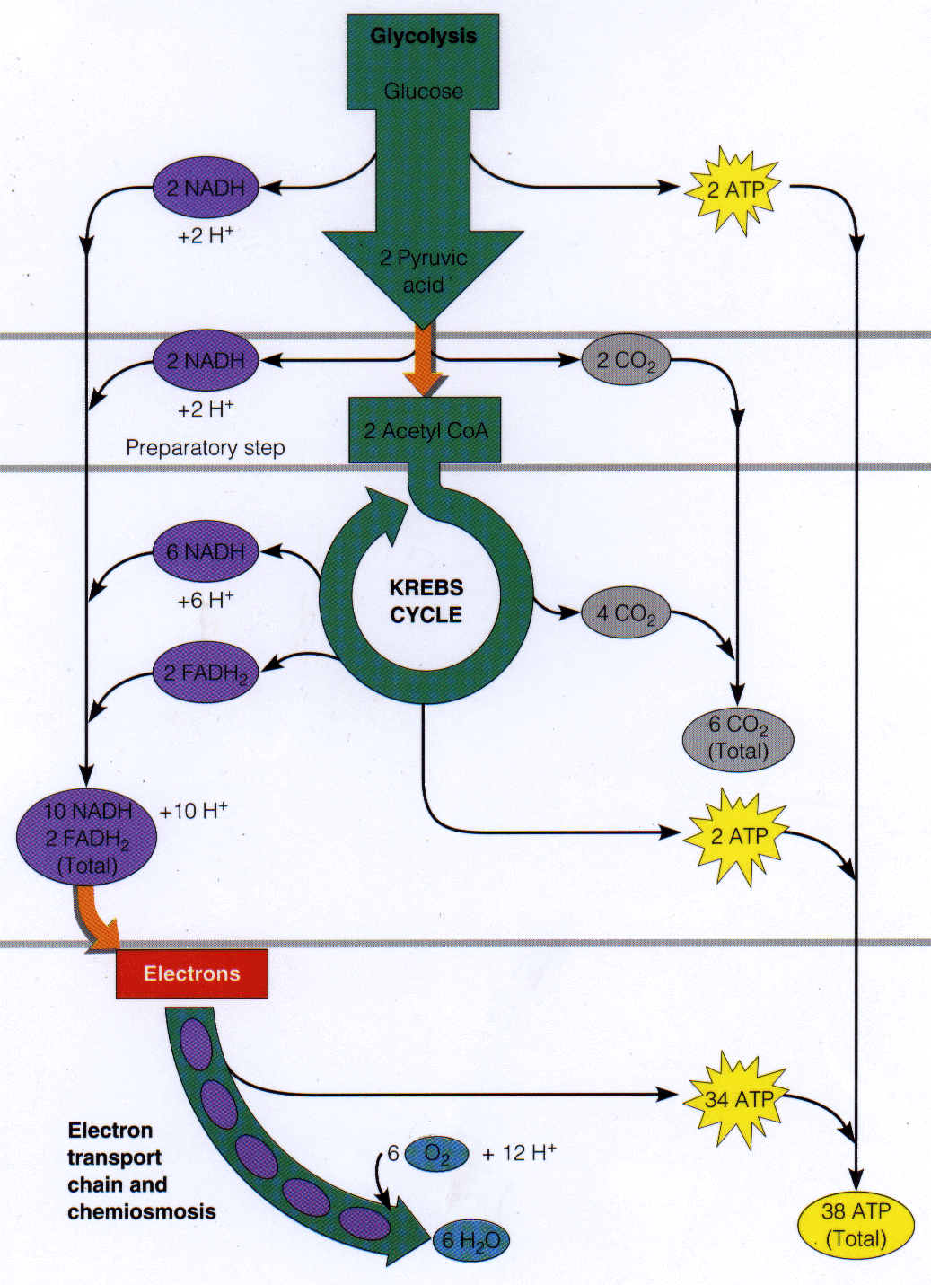
Aerobic Metabolism

Slide 15
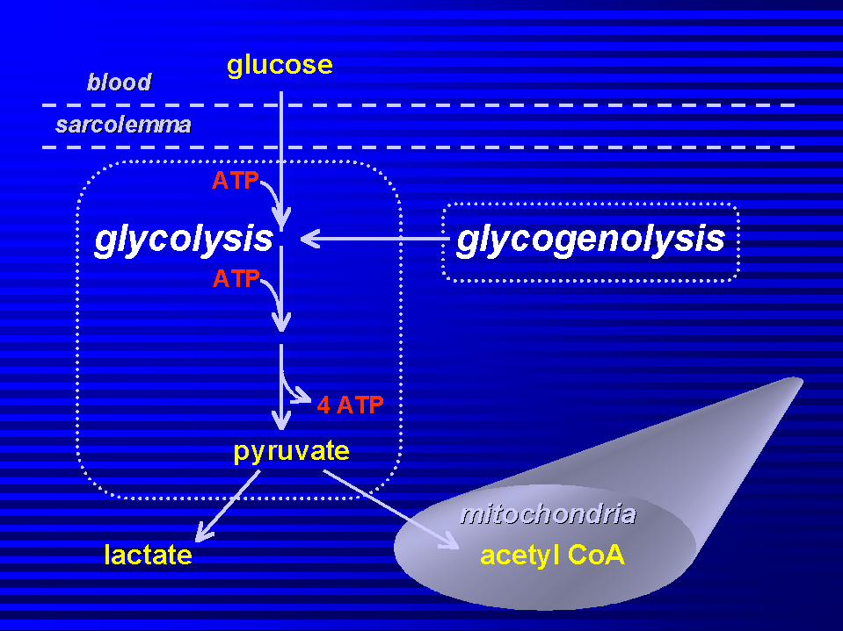
Anaerobic metabolism

Slide 16
Acidosis
Increased splenic bleeding by 47%
Delays RATE of thrombin generation
All enzymes systems (clotting factors) dramatically compromised by
7% increase hematocrit due to RBC swelling-→increased viscosity→”no flow” reperfusion phenomenon

Slide 17
Coagulopathy
Focus of Damage Control Resuscitation
Secondary to hypothermia and acidosis……..
……..and a primary effect in trauma ??

Slide 18
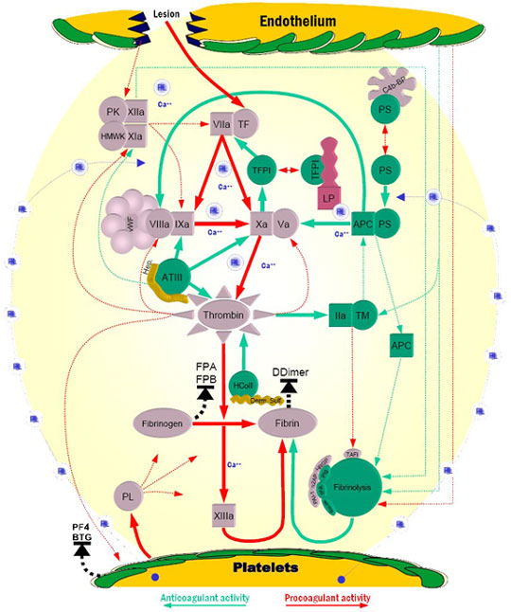
Coagulation

Slide 19
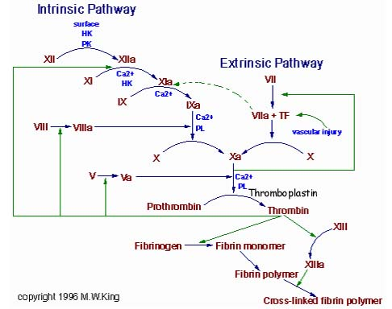
Coagulation

Slide 20
Damage Control Resuscitation
Crystalloids
  Increase hemodilution
  Exacerbate hypothermia
  NS supraphysiologic→ increased chloride→increased H2O dissociation→increased H+→ worsening acidosis
  Temporary increase in intravascular pressure causes increased loss of platelets (damage control party) and clotting factors (materials)

Slide 21
Mattox and Hicks
Demonstrated 100% mortality in pig model resuscitated using normal ATLS protocols.
Demonstrated 100% survival in non-resuscitated animals; all required euthanasia
Used as justification for elimination of MAST pants
Let to follow on study by Pepe………..

Slide 22
Pepe et al
Randomized penetrating trauma patients to “normal” crystalloid resuscitation using ATLS standards vs. hypotensive resuscitation in Houston
Demonstrated improved survival in patients with interventions delayed until OR.

Slide 23
Current Concepts in Hemorrhagic Shock
Vasoconstriction of ischemia tolerant vascular beds
  Diverts to vital organs
Injured tissues release mediators to constrict blood flow and reduce bleeding.
Apoptosis = “programmed cell death”
Cellular hibernation

Slide 24
Current Concepts in Hemorrhagic Shock
More than transient tissue hypoxia
  “No reflow” phenomenon
  Toxic metabolites released with reperfusion
  Occult hypoperfusion microcirculation
  Delayed multisystem organ failure

Slide 25
Lungs
Downstream filter for toxic metabolites
Bacteria translocate from gut
Acute Respiratory Distress Syndrome (ARDS) described in 1960’s as “Da Nang Lung”.
Exacerbated by PPV, ventilator associated pneumonia

Slide 26
Acid-Base Balance - pH
pH-normal range 7.35-7.45
Factor VIIa 90% ineffective at pH 7.1
pH below 7.0 correlates with near 100% mortality
pH is logarithmic
  Each 0.1 change in pH represents a ten-fold change in the amount of H+ ions in plasma.

Slide 27
Resuscitaion Fluids
Crystalloids
  Isotonic
  Hypertonic
Colloids
Plasma
Blood Products
Whole blood

Slide 28
Normal Saline
  Cheap, nonallergenic
  pH = 5.0-6.5
  Supraphysiologic amounts of Na + and Cl-
  Use may lead to hyperchloremic metabolic acidosis
  Delay in urine output compared to LR
  Cerebral edema in TBI

Slide 29
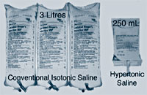
Hypertonic Saline
2.7% NS in US
7.5% in Europe
HSD (HS with Dextran 6%)
Small volume resus
TBI benefit

Slide 30
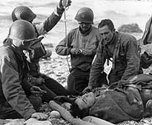
Plasma
Replace clotting factors
10-15 mL/kg= 4 units FFP
FFP is plasma with platelets removed
Resuscitation fluid of choice

Slide 31
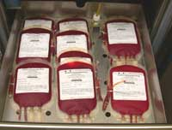
Blood Products
Whole Blood
Packed RBC’s
Fresh Frozen Plasma
Platelets (Cryoprecipitate)

Slide 32
Fresh Whole Blood
Uncrossmatched Type Specific Blood
Citrate as anticoagulation factor

Slide 33
Damage Control
Stop Bleeding
Augment Clotting Factors
Redirect volume
Transfuse FWB

Slide 34
Hemorrhage Control
(Plug the Hole)
Factor VIIa
Plasma
Thrombin ?
Vasopressin ?
Notes:
Disproportionate clotting factors lost in hemorrhage

Slide 35
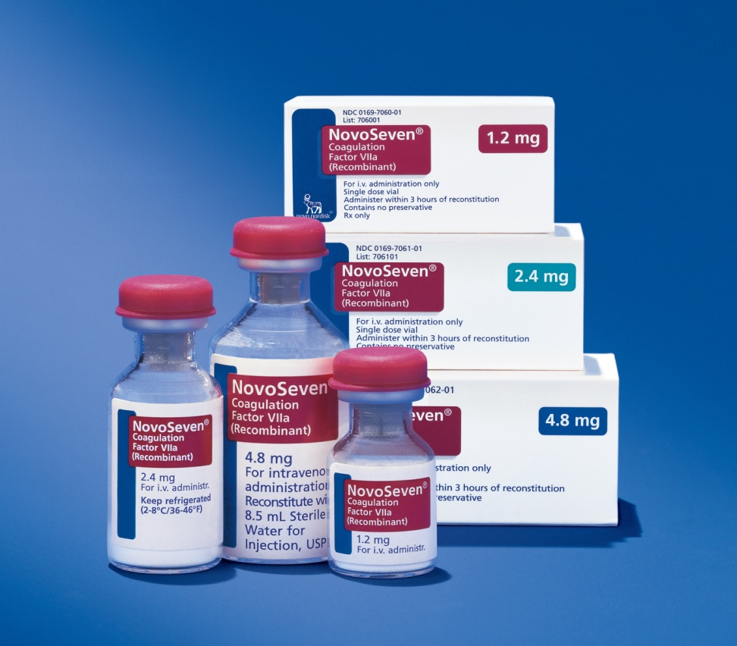
Factor VIIa
Combines with TF to activate Factor X
Extrinsic pathway
Reduces amount of blood, platelets transfusion requirements
Similar/Improved survival in trauma patients

Slide 36
Factor VIIa
EARLY administration associated with better outcomes.
Penetrating abdominal/thoracic trauma with ANY evidence of hemorrhage.
Administer NaHCO3 and Ca+ before/after administration.
Followed by Plasma ?
Followed by Thrombin at wounding site if possible ?

Slide 37
“Low dose” rFactor VIIa
Reduced blood and blood product use in traumatic hemorrhage.
Fewer RBC’s, platelets, cryo required in matched patients by ISS.
Equivalent mortality in both groups.
Harrison TD, et al. J Trauma July 2005

Slide 38
Early Factor VIIa use in combat trauma
Retrospective review all patients in OIF receiving massive transfusions JAN 2004-OCT 2005
Factor VIIa received either before OR after transfusion
Early group used required 20% less blood.
Similar mortality, infection, and thrombotic event rates.
Perkins JG et al. J Trauma May 2007

Slide 39
More early Factor VIIa
Retrospective review 124 trauma patients in OIF with ISS >15, and received > 10 units PRBC’s
49 received Factor VIIA, 75 did not.
24 hour mortality Factor VIIA 7/49 = 14%
24 hour mortality in non Factor VIIa 26/75 = 35%
Spinella PC et al. J Trauma Feb 2008

Slide 40
Plasma
Resuscitation fluid of choice
Restores clotting components
Lypholized products
  Europe
  HemCon

Slide 41
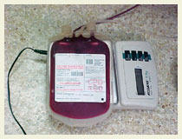
Blood Transfusion
Fresh whole blood
Greater Hct
More active clotting factors
5X more platelet activity vs frozen
Earlier in resuscitation

Slide 42
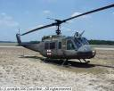
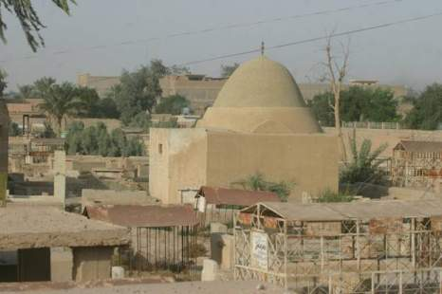

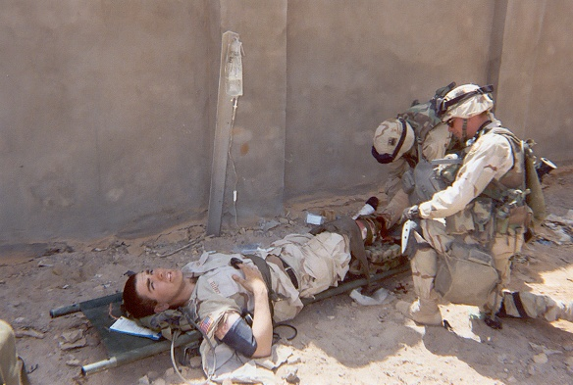
Trauma: Surviving Blood Loss
Objective: Extend survival from the “Golden Hour” to the “Golden Six Hours” by controlling the availabilty and demand for oxygen in the injured warfighter
2008
1950s to 1990s
Hemorrhage accounts for > 50% of OIF / OEF battlefield fatalities.
Severe blood loss causes irreversible injury by decreasing oxygen and substrate delivery to tissues.
Evacuation times are prolonged (4-6 hours) due to urban and mountainous terrains, eliminating the possibility of rapid blood or fluid resuscitation.
Rapid evacuation
Immediate treatment with fluids and blood “The Golden Hour”
FOR OFFICIAL USE ONLY
42
Notes:
42

Slide 43
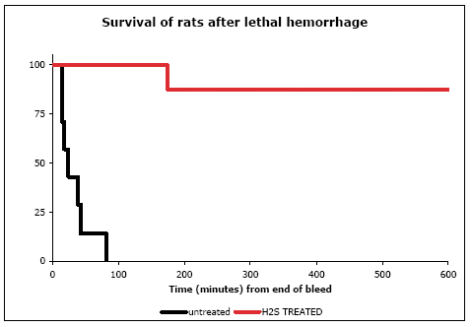
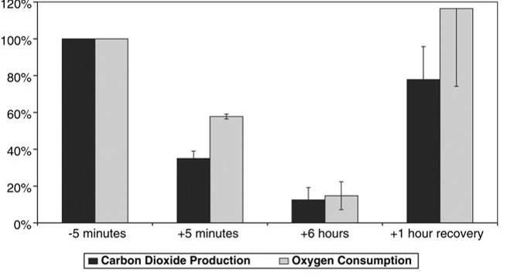

Surviving Blood Loss
Metabolic Control Using H₂S Therapy
H₂S Effects LD90 Pigs
(60% hemorrhage, post treatment)
Approach: Use therapeutic compounds containing sulfur to minimize oxygen demand and chemically substitute for oxygen as an electron receptor
100
75
H₂S-treated Group (n=7)
% Survival
50
Suspended Animation Induced
in Rodents
25
Control Group (n=7)
0
0
100
200
300
400
500
600
Time (min) from end of bleed
Science, 2005
Clinical Development Plan
Ikaria Inc. is the commercialization partner for H₂S Therapies
GMP inhalation and intravenous formulations produced
Phase I human clinical trials
ongoing in two centers
FOR OFFICIAL USE ONLY
43
Notes:
43

Slide 44
Surviving Blood Loss
Sterol-Based Systemic Protection
Female animals survive hemorrhagic shock
better than males by a factor of two
DARPA Estrogen Therapy in Rodents
Cardiac Index During Hemorrhage
50
Sham
Hemorrhage
100
40
80
Premarin (5mg/kg)
66%
n=9
Cardiac Output
*
% Survival
60
30
40
Vehicle Control
0%
n=16
20
20
Male
Female
0
0
60
120
180
240
300
360
Time (minutes)
Results in Swine Model
Commercial Transition
Hemorrhage Start
Hemorrhage End; Treatment infused
150
  Barr Pharmaceuticals
  > $1B in revenues; leader in oral contraceptives and hormone replacement therapies
Blood Pressure
Estrogen
100
Mean BP (mmHg)
50
Control
0
0
50
100
150
200
250
Time (min)
FOR OFFICIAL USE ONLY
44
Notes:
44

Slide 45
Summary
Create thrombus
  Factor VIIa, cofactors
Prime coagulation cascade
  thrombin, plasma
Aggressive resuscitation
  Blood, HBOC
Extend survival
  hormonal therapy, H2S
  future/further research

